Slide 1

Tracing in NS-3
DRAFT Version 1
May, 2014
Walid Younes
This work was performed under the auspices of the U.S. Department of Energy by Lawrence Livermore National Security, LLC, Lawrence Livermore National Laboratory under Contract DE-AC52-07NA27344.

Slide 2
Chapter 7: Tracing
Source material:
Online tutorial: http://www.nsnam.org/docs/release/3.14/tutorial/singlehtml/index.html#tracing
T. Predojev (2012): http://wikienergy.cttc.es/images/2/2d/Ns-3-tutorial-complete.pdf
M. Lacage (2009): http://www.nsnam.org/tutorials/ns-3-tutorial-tunis-apr09.pdf
G. Riley (2008): http://www.wns2.org/docs/wns_tutorial-handout.pdf
S. Kristiansen (2010): http://www.uio.no/studier/emner/matnat/ifi/INF5090/v11/undervisningsmateriale/INF5090-NS-3-Tutorial-2011-Oslo-slides.pdf

Slide 3
More advanced tracing with NS3
You can use ascii, pcap tracing or logging to get info from your sim
Need to write code to parse output
The info you want may not be obtainable by pre-defined mechanisms
There is another way in NS3
Add your own traces to events you care about
Produce output in a convenient form
Add hooks to the core that can be accessed by other users later

Slide 4
You could use print statements, but I wouldn’t recommend it
You may have to dig deep inside the NS3 core to find the info you want
More print statements ⇒ need way to enable/disable specific ones
Congratulations! You’ve just re-invented the NS3 logging system!
You could add logging statements to the core
Remember: NS3 is open-source, evolving system
Core will bloat to include all possible log messages
Unwieldy gigantic log files ⇒ effectively useless
No guarantee specific log messages will survive releases
Logging ≠ Tracing

Slide 5
The basic idea: trace sources and sinks
You need:
Trace source: signals sim event and provides access to the data
Trace sink: consumes the trace info, do something useful with it
Mechanism to connect trace source to trace sink
Note: there can be many sinks connected to the same trace source
Trace sink
Trace source
Trace sink
Trace sink

Slide 6
A simple low-level example: callbacks
This is the key to the way tracing works
In C/C++ you can pass a pointer to a function: callback mechanism
Trace source maintains a list of callback functions added by the sinks
When an event of interest happens
Trace source passes data to the callback functions
Callback functions are executed
Ex: a function to integrate functions
float myFunction(float x)
{
return x*x;
}
⋮
float Integrate(float (*func)(float), float lo, float hi)
{
…
}
⋮
Integrate(&myFunction,0,1);

Slide 7
A simple low-level example: fourth.cc
#include "ns3/object.h"
#include "ns3/uinteger.h"
#include "ns3/traced-value.h"
#include "ns3/trace-source-accessor.h"
#include <iostream>
using namespace ns3;
class MyObject : public Object
{
public:
static TypeId GetTypeId (void)
{
static TypeId tid = TypeId ("MyObject")
.SetParent (Object::GetTypeId ())
.AddConstructor<MyObject> ()
.AddTraceSource ("MyInteger",
"An integer value to trace.",
MakeTraceSourceAccessor (&MyObject::m_myInt));
return tid;
}
MyObject () {}
TracedValue<int32_t> m_myInt;
};
void IntTrace (int32_t oldValue, int32_t newValue)
{
std::cout << "Traced " << oldValue << " to " << newValue << std::endl;
}
int main (int argc, char *argv[])
{
Ptr<MyObject> myObject = CreateObject<MyObject> ();
myObject->TraceConnectWithoutContext ("MyInteger", MakeCallback (&IntTrace));
myObject->m_myInt = 1234;
}
Goal: trace changes made to a variable
i.e., notify user whenever
+, ++, =, etc.
Trace source
Trace sink
Connection

Slide 8
A simple-low level example: the trace source
MyObject is derived from Object, inherits public members
class MyObject : public Object
{
public:
static TypeId GetTypeId (void)
{
static TypeId tid = TypeId ("MyObject")
.SetParent (Object::GetTypeId ())
.AddConstructor<MyObject> ()
.AddTraceSource ("MyInteger",
"An integer value to trace.",
MakeTraceSourceAccessor (&MyObject::m_myInt));
return tid;
}
MyObject () {}
TracedValue<int32_t> m_myInt;
};
always need GetTypeId method for an object
provides run-time info on type
allows objects to located via path (more on this later)
provides objects with attributes
provides objects with trace sources

Slide 9
A simple-low level example: the trace source
TypeId class records meta-information about MyObject
class MyObject : public Object
{
public:
static TypeId GetTypeId (void)
{
static TypeId tid = TypeId ("MyObject")
.SetParent (Object::GetTypeId ())
.AddConstructor<MyObject> ()
.AddTraceSource ("MyInteger",
"An integer value to trace.",
MakeTraceSourceAccessor (&MyObject::m_myInt));
return tid;
}
MyObject () {}
TracedValue<int32_t> m_myInt;
};
Provides unique identifier
Record TypeId of base class
Default constructor is accessible
Provides hook to connect to trace source:
Name of source
Help string
Accessor = pointer to connect
Provides infrastructure to
Overload operators
Drive callback process

Slide 10
A simple low-level example: the trace sink
void IntTrace (int32_t oldValue, int32_t newValue)
{
std::cout << "Traced " << oldValue << " to " << newValue << std::endl;
}
A simple void function
Takes in the old and new values of the traced variable
Will be supplied by the trace source
Prints them to the screen

Slide 11
A low-level example: the main function
NS3 smart pointers provide garbage collection via reference counting
Track number of pointers to an object
Helps avoid memory leaks when you forget to delete an object
Wrapper for C++ “new”
int main (int argc, char *argv[])
{
Ptr<MyObject> myObject = CreateObject<MyObject> ();
myObject->TraceConnectWithoutContext ("MyInteger", MakeCallback (&IntTrace));
myObject->m_myInt = 1234;
}
If all goes as planned: should trigger callback
Connecting source to sink
“MyInteger” = name of source
Callback made from our sink function
We’ll talk about “Context” next…

Slide 12
A low-level example: running fourth.cc
cp examples/tutorial/fourth.cc scratch/myfourth.cc
./waf --run scratch/myfourth
Traced 0 to 1234
Assignment in: myObject->m_myInt = 1234;
triggers callback
Seems almost anticlimactic, but we’ve illustrated the main steps in tracing
Define trace source
Define trace sink
Connect trace source to trace sink

Slide 13
Using Config to connect to trace sources
TraceConnectWithoutContext is not typical way to connect source to sink
Normally done via the Config subsystem in ns3, by using a config path
A string that looks like a file path
Represents chain of objects leading to the desired event (or attribute)
We encountered this in third.cc
”/NodeList/7/$ns3::MobilityModel/CourseChange"
Provides a path to the “CourseChange” attribute for node index 7
Let’s dissect this config path

Slide 14
Dissecting the Config path in third.cc
”/NodeList/7/$ns3::MobilityModel/CourseChange"
“NodeList” = predefined namespace in Config, lists all the nodes in the sim
"NodeList/7" = node 7 (i.e., the eigth node)
"$" = what follows designates an aggregated object
Let’s take a short detour to discuss aggregated objects in NS3

Slide 15
Object aggregation in NS3
Makes it possible for objects to access each other, and for users to easily access objects in an aggregation
Avoids need to modify a base class to provide pointers to all possible connected objects
Class definitions would bloat uncontrollably
Solution: separate functionality belongs to separate classes
Node->AggregateObject(mobility);
node
mobility
node
mobility
Retrieving an aggregated object:
Ptr<MobilityModel> mob = node->GetObject<MobilityModel> ();

Slide 16
Dissecting the Config path in third.cc
”/NodeList/7/$ns3::MobilityModel/CourseChange"
“NodeList” = predefined namespace in Config, lists all the nodes in the sim
"NodeList/7" = node 7 (i.e., the eigth node)
"$" = what follows designates an aggregated object
"/NodeList/7/$ns3::MobilityModel" = get the mobility model object aggregated to node 7 in the sim
"CourseChange" = attribute of MobilityModel we are interested in
Config will follow the chain of pointers to the attribute you specified
Config::Connect(”/NodeList/7/$ns3::MobilityModel/CourseChange”,MakeCallback(&CourseChange))
Ties the trace source to the trace sink callback function
Passes the context (= config path) to the callback function

Slide 17
How to Find and Connect Trace Sources, and Discover Callback Signatures
What trace sources are available (besides CourseChange)?
How do I figure out the config path I need to connect to this source?
What are the return type and arguments of my callback function?
void CourseChange(std::string context,Ptr<const MobilityModel> model)
Void IntTrace (int32_t oldValue, int32_t newValue)
Doxygen and a little detective work will go a long way here

Slide 18
What trace sources are available?
Doxygen has the answer!
Trace sources: http://www.nsnam.org/docs/release/3.16/doxygen/group___trace_source_list.html
Attributes: http://www.nsnam.org/docs/release/3.16/doxygen/group___attribute_list.html
Global values: http://www.nsnam.org/docs/release/3.16/doxygen/group___global_value_list.html

Slide 19
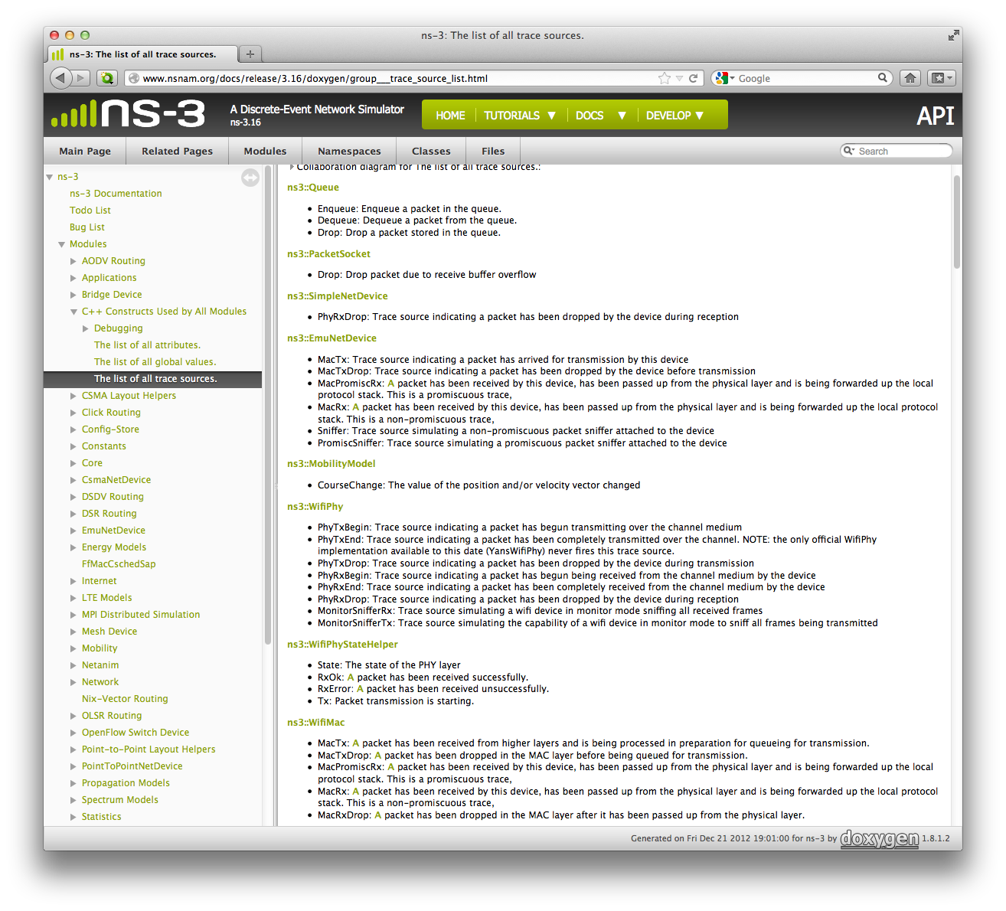

What trace sources are available?

Slide 20
What string do I use to connect?
method 1: look for config path in someone else’s code
find -name "*.cc" | xargs grep CourseChange | grep Connect
Config path = "/NodeList/*/$ns3::MobilityModel/CourseChange”
you can use regular expressions in the path, so "*" ⇒ any node
"/NodeList/[3-5]∣8∣[0-1]" would match node indices 0,1,3,4,5,8
⋮
./src/mobility/examples/main-random-walk.cc: Config::Connect ("/NodeList/*/$ns3::MobilityModel/CourseChange",
⋮

Slide 21
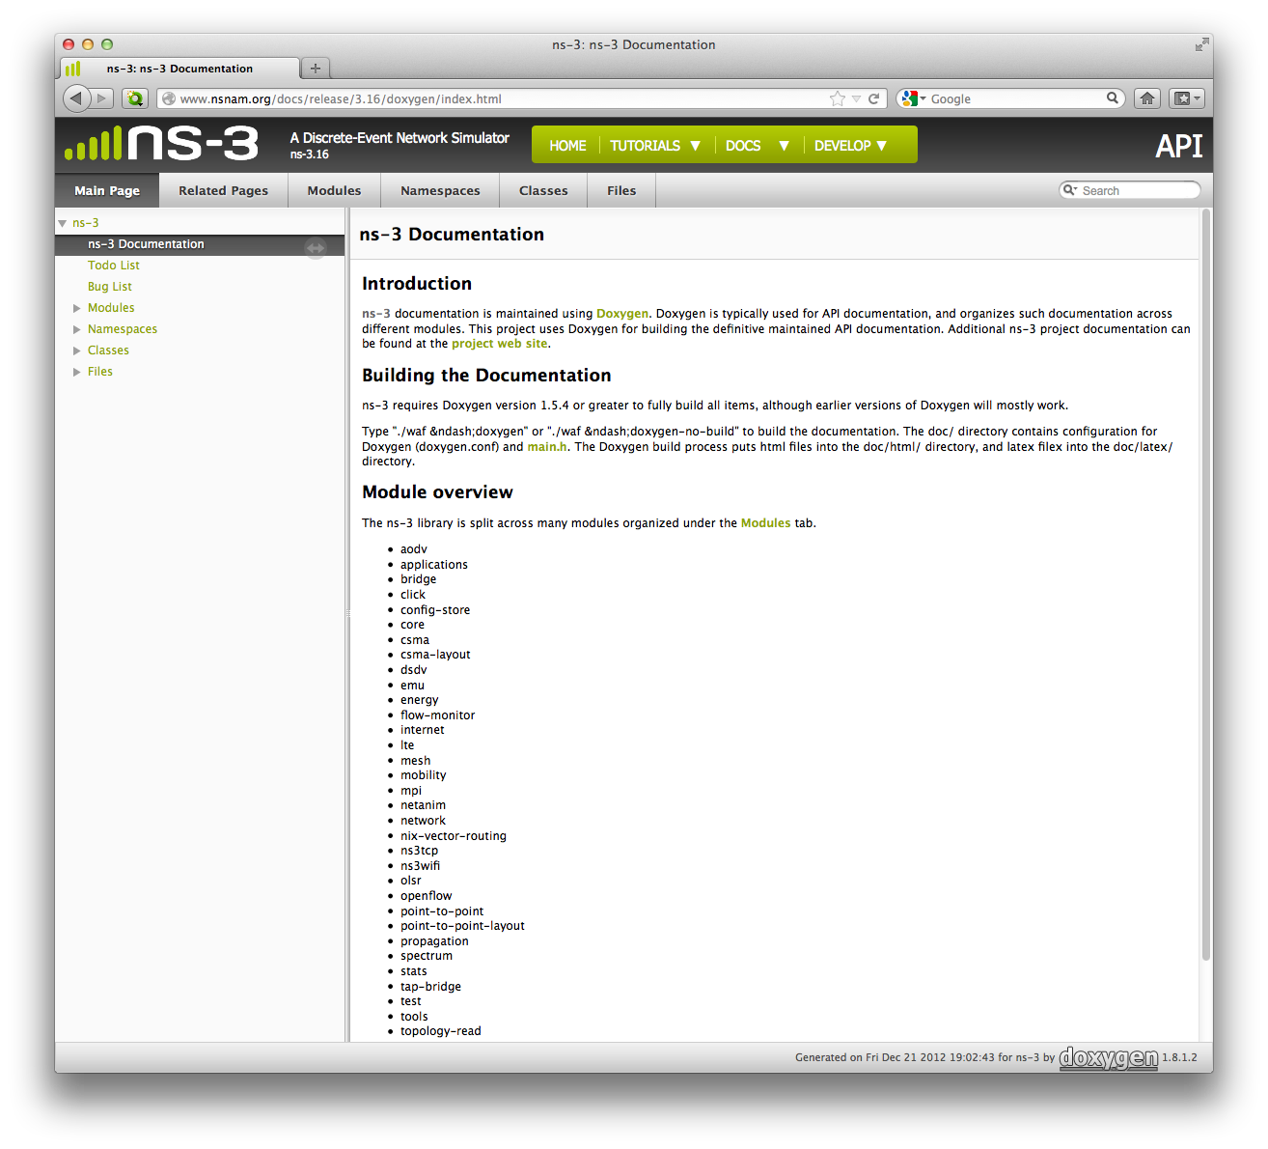
What string do I use to connect?
method 2: Doxygen
RandomWalk2dMobilityModel

Slide 22
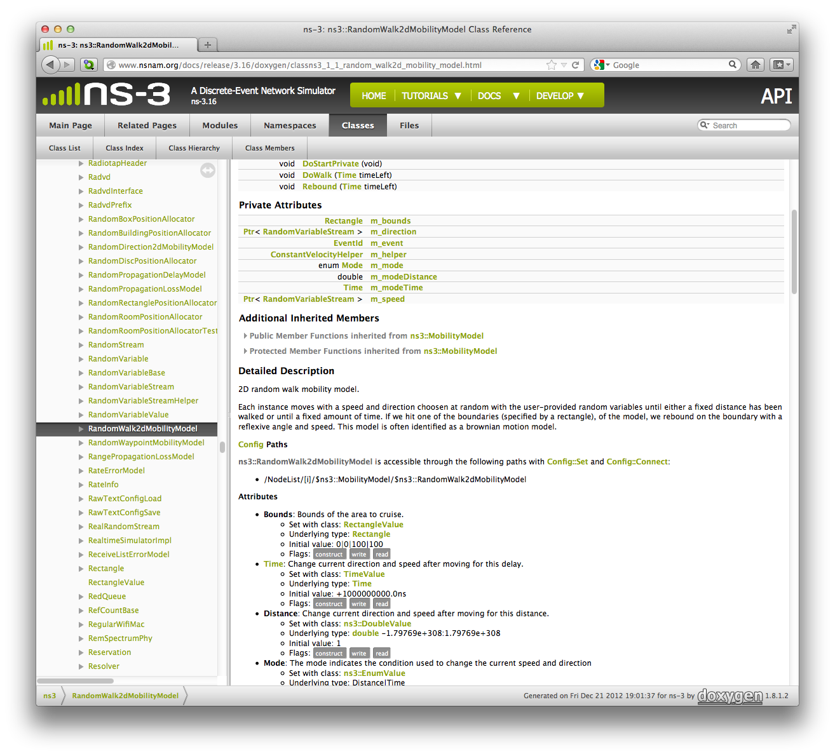
What string do I use to connect?
method 2: Doxygen
Remember: before, we used:
"NodeList/7/$ns3::MobilityModel/CourseChange"
We’re almost there! We found:
But what’s this bit?
Scroll further down

Slide 23
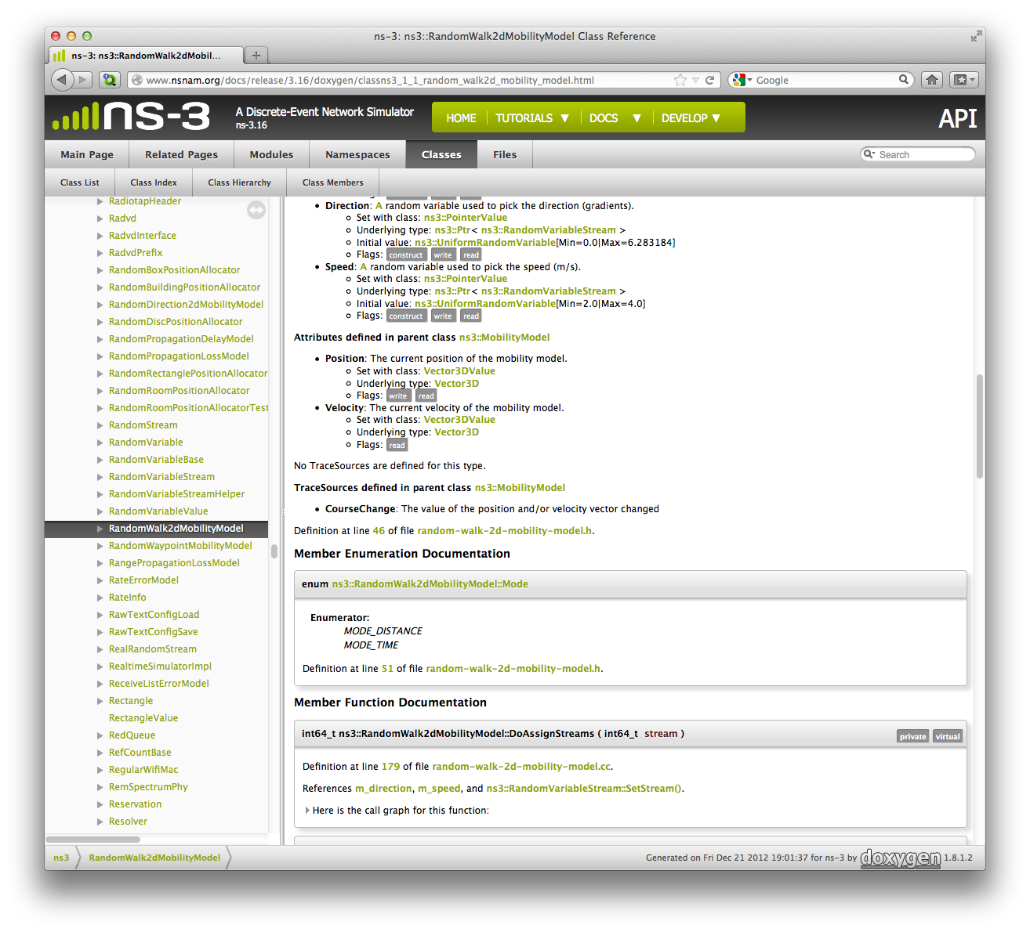

What string do I use to connect?
method 2: Doxygen
This tells you to access the “CourseChange” attribute from the parent class, so:
"NodeList/7/$ns3::MobilityModel/CourseChange"

Slide 24
What are the return value and arguments for the callback function?
The easy way: copy someone else’s answer
find -name "*.cc" | xargs grep CourseChange | grep Connect
Inside “./src/mobility/examples/main-random-walk.cc”:
And we then find the header of the “CourseChange” function:
./src/mobility/examples/main-random-walk.cc: Config::Connect ("/NodeList/*/$ns3::MobilityModel/CourseChange”,
Config::Connect ("/NodeList/*/$ns3::MobilityModel/CourseChange",
MakeCallback (&CourseChange));
static void CourseChange (std::string foo, Ptr<const MobilityModel> mobility)
But what if you can’t find what you need in someone else’s code?

Slide 25
What return value and arguments for the callback function?
The somewhat easy way
The return value is always “void”
To get the list of formal arguments, look in the ".h" file for the model
Find the "TracedCallback" declaration
For ex,in "src/mobility/model/mobility-model.h”
So for callback using Config::ConnectWithoutContext
And for callback using Config::Connect
TracedCallback<Ptr<const MobilityModel> > m_courseChangeTrace;
This is the argument we need!
void CourseChange(Ptr<const MobilityModel> model)
void CourseChange(std::string path,Ptr<const MobilityModel> model)
Context (= config path) gets passed here

Slide 26
What about TracedValue?
Remember we used the callback function
How did we guess the right formal arguments to use?
Find "TracedCallback" declaration in "src/core/model/traced-value.h”
In fourth.cc, inside the MyObject class, we declared
T = int32_t
Two arguments in the callback, both of type T (i.e., int32_t)
void IntTrace(int32_t oldValue, int32_t newValue)
template <typename T> class TracedValue
{
public:
...
private:
T m_v;
TracedCallback<T,T> m_cb;
};
Template class ⇒ you get to choose its type
TracedValue<int32_t> m_myInt;

Slide 27
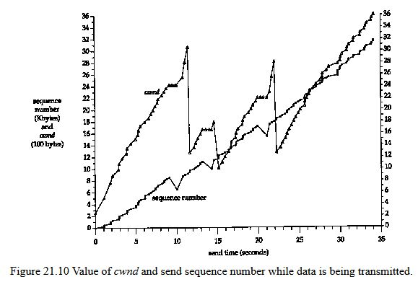
A real example
From W. Richard Stevens, “TCP/IP Illustrated, Vol. I: The Protocols”, Addison-Wesley (1994)
Congestion window
Goal: simulate a TCP congestion window and look at the effect of dropped packets

Slide 28
Congestion windows 101 (from Wikipedia)
Congestion collapse occurs at choke points in the network
Wherever total incoming traffic to a node > outgoing bandwidth
e.g., connection points between LAN and WAN
TCP uses network congestion avoidance algorithm
Congestion window is part of TCP strategy to avoid congestion collapse
Limits total number of unacknowledged packets that may be in transit
The size of the window is adjusted dynamically by the sender
Based on how much congestion between sender and receiver
If all segments are received and the acks reach the sender on time
Add a constant to the window (typically 1 MSS = Max Segment Size)
Otherwise
Scale back by a set factor (typically 1/2)
Explains “sawtooth” shape of congestion window over time

Slide 29
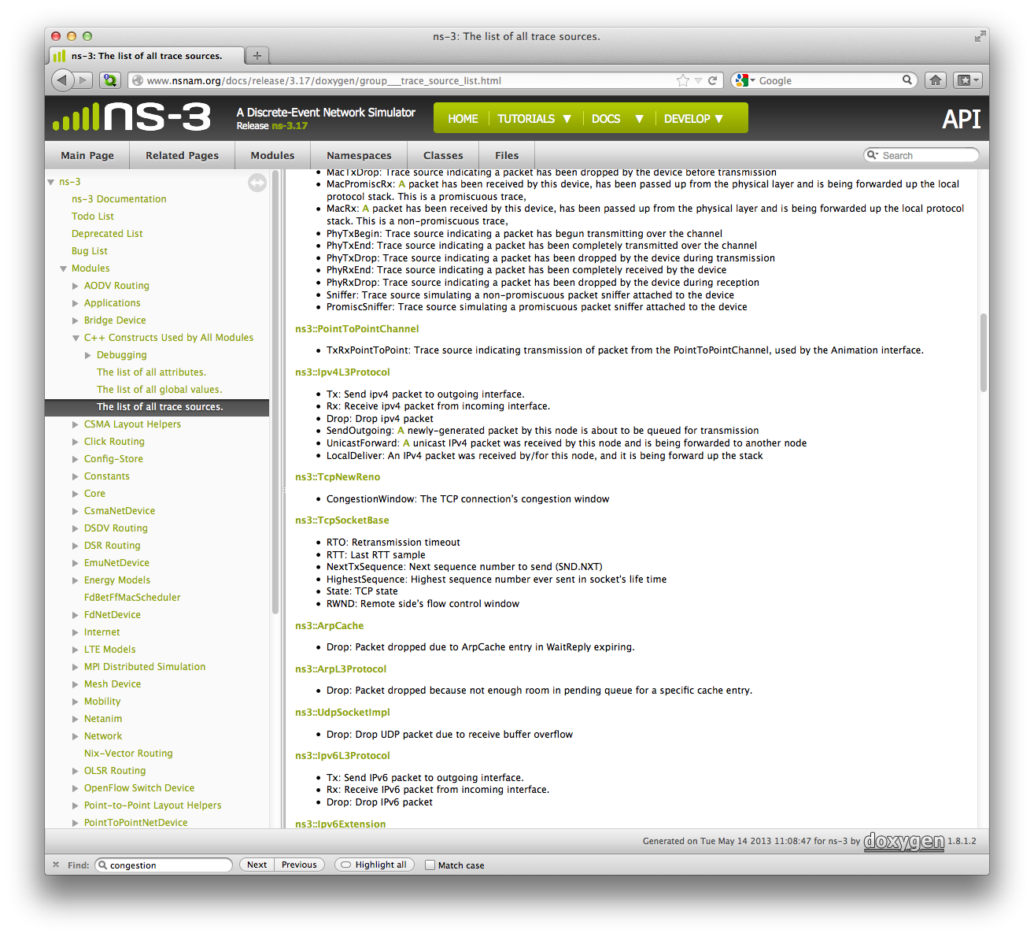

Are there trace sources available?
From Doxygen’s "The list of all trace sources"
Look for “congestion”:
We have our trace source:
CongestionWindow
Click on “ns3::TcpNewReno” to access class info

Slide 30
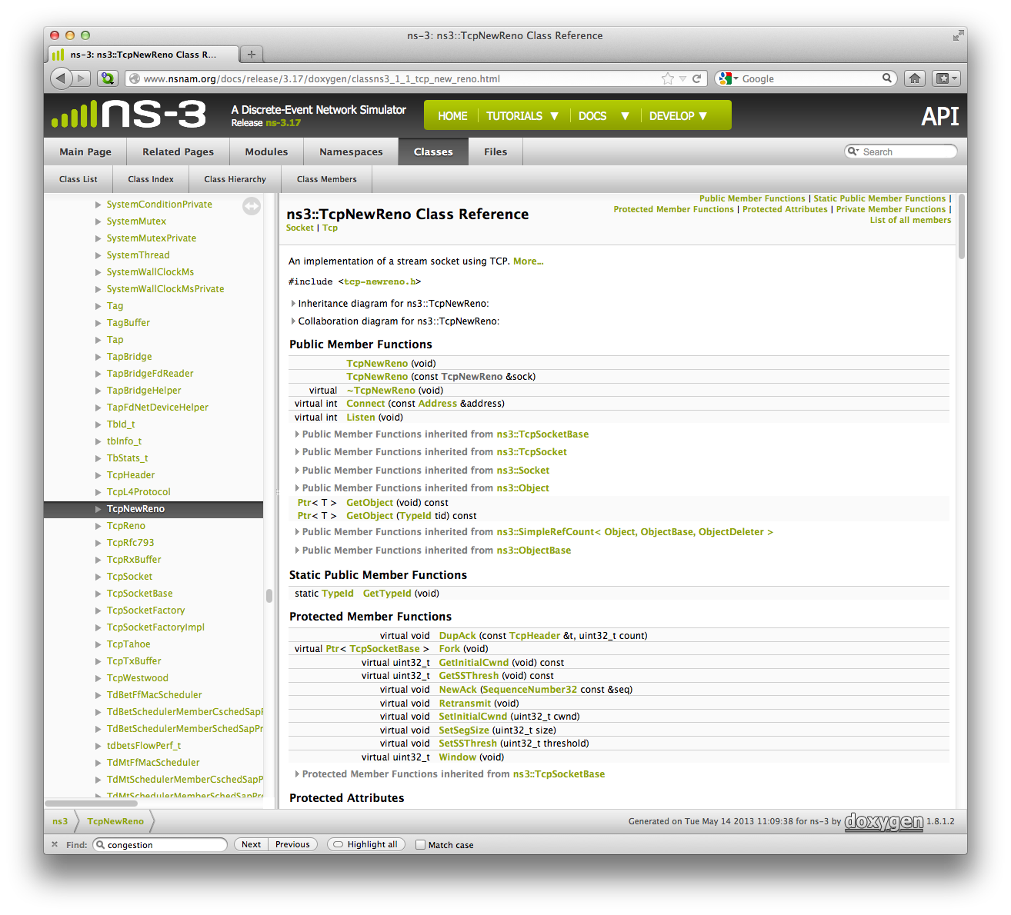
Are there trace sources available?
From Doxygen’s "The list of all trace sources"
Click on link to header file “tcp-newreno.h”
Look for keyword “congestion”

Slide 31
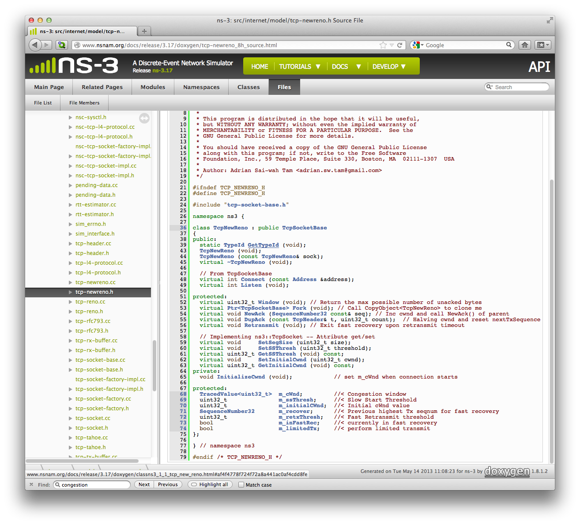
Are there trace sources available?
From Doxygen’s "The list of all trace sources"
TracedValue<uint32_t> m_cWnd; //< Congestion window
this looks a lot like our fourth.cc example
we'll need a callback function of the form
void CwndTrace(uint32_t oldValue,uint32_t newValue)

Slide 32
How do we get started writing our script?
The time-honored way: steal from someone else’s code
find . -name “*.cc” | xargs grep CongestionWindow
Look, e.g., in “./src/test/ns3tcp/ns3tcp-cwnd-test-suite.cc”
The connection between trace and source is done by
We can also copy code from the function
ns3TcpSocket->TraceConnectWithoutContext ("CongestionWindow", MakeCallback (&Ns3TcpCwndTestCase1::CwndChange, this));
This is the callback function
void CwndChange (uint32_t oldCwnd, uint32_t newCwnd)
void Ns3TcpCwndTestCase1::DoRun (void)
This is how fifth.cc was put together

Slide 33
Avoiding a common mistake in NS3
NS3 scripts execute in three separate stages
Configuration time
Simulation time (i.e., Simulator::Run)
Teardown time
TCP uses sockets to connect nodes
Sockets are created dynamically during simulation time
Want to hook the CongestionWindow on the socket of the sender
Connection to trace sources is established during configuration time
Can’t put the cart before the horse!
Solution:
Create socket at configuration time
Hook trace source then
Pass this socket object to system during simulation time
Next: fifth.cc walkthrough

Slide 34
Overview of fifth.cc
Dumbbell topology, point-to-point network, like first.cc
We will create our own application and socket
So we can access socket at configuration time
No helper, so we’ll have to do the work manually
Connect to CongestionWindow trace source in sender socket
Introduce errors into the channel between nodes
Dropped packets ⇒ interesting behavior in congestion window
0
1
Sender
Receiver

Slide 35
Creating our own application: the MyApp class
class MyApp : public Application
{
public:
MyApp ();
virtual ~MyApp();
void Setup (Ptr<Socket> socket, Address address, uint32_t packetSize, uint32_t nPackets, DataRate dataRate);
private:
virtual void StartApplication (void);
virtual void StopApplication (void);
void ScheduleTx (void);
void SendPacket (void);
Ptr<Socket> m_socket;
Address m_peer;
uint32_t m_packetSize;
uint32_t m_nPackets;
DataRate m_dataRate;
EventId m_sendEvent;
bool m_running;
uint32_t m_packetsSent;
};
Initializes member variables
But this is the important bit: we will be able to
Create socket
Hook its CongestionWindow trace source
Pass the socket to the application
All this at configuration time!

Slide 36
Creating our own application: the MyApp class
class MyApp : public Application
{
public:
MyApp ();
virtual ~MyApp();
void Setup (Ptr<Socket> socket, Address address, uint32_t packetSize, uint32_t nPackets, DataRate dataRate);
private:
virtual void StartApplication (void);
virtual void StopApplication (void);
void ScheduleTx (void);
void SendPacket (void);
Ptr<Socket> m_socket;
Address m_peer;
uint32_t m_packetSize;
uint32_t m_nPackets;
DataRate m_dataRate;
EventId m_sendEvent;
bool m_running;
uint32_t m_packetsSent;
};
We also need to override these with our own implementations that will be called by the simulator to start and stop

Slide 37
Creating our own application: the MyApp class
class MyApp : public Application
{
public:
MyApp ();
virtual ~MyApp();
void Setup (Ptr<Socket> socket, Address address, uint32_t packetSize, uint32_t nPackets, DataRate dataRate);
private:
virtual void StartApplication (void);
virtual void StopApplication (void);
void ScheduleTx (void);
void SendPacket (void);
Ptr<Socket> m_socket;
Address m_peer;
uint32_t m_packetSize;
uint32_t m_nPackets;
DataRate m_dataRate;
EventId m_sendEvent;
bool m_running;
uint32_t m_packetsSent;
};
2
1
StartApplication calls SendPacket
SendPacket calls ScheduleTx
ScheduleTx set up next SendPacket call
…
Until StopApplication
3

Slide 38
The trace sinks
We want to trace 2 types of events
Updates to the congestion window:
Dropped packets
static void CwndChange (uint32_t oldCwnd, uint32_t newCwnd)
{
NS_LOG_UNCOND (Simulator::Now ().GetSeconds () << "\t" << newCwnd);
}
static void RxDrop (Ptr<const Packet> p)
{
NS_LOG_UNCOND ("RxDrop at " << Simulator::Now ().GetSeconds ());
}

Slide 39
Introducing errors in the channel
Determines which packets are errored corresponding to underlying
Distribution = random variable
Rate ↔ mean duration between errors
Unit = per-bit, per-byte, or per-packet
Ptr<RateErrorModel> em = CreateObjectWithAttributes<RateErrorModel> (
"RanVar", RandomVariableValue (UniformVariable (0., 1.)),
"ErrorRate", DoubleValue (0.00001));
devices.Get (1)->SetAttribute ("ReceiveErrorModel", PointerValue (em));
Will cause randomly dropped packets in the receiver device

Slide 40
Setting the application on the receiver node
uint16_t sinkPort = 8080;
Address sinkAddress (InetSocketAddress (interfaces.GetAddress (1), sinkPort));
PacketSinkHelper packetSinkHelper ("ns3::TcpSocketFactory", InetSocketAddress (Ipv4Address::GetAny (), sinkPort));
ApplicationContainer sinkApps = packetSinkHelper.Install (nodes.Get (1));
sinkApps.Start (Seconds (0.));
sinkApps.Stop (Seconds (20.));
PacketSink receives and consumes traffic generated to an IP address and port
PacketSinkHelper creates sockets using an “object factory”
Object factories are used to mass produce similarly configured objects
Factory method doesn’t require you to know the type of the objects created

Slide 41
Connecting the sender’s socket, and connecting the trace source
Another way of creating a socket using a socket factory
Ptr<Socket> ns3TcpSocket = Socket::CreateSocket (nodes.Get (0), TcpSocketFactory::GetTypeId ());
ns3TcpSocket->TraceConnectWithoutContext ("CongestionWindow", MakeCallback (&CwndChange));
This should look familiar by now
Because we created our own app and socket at configuration time we can hook into its CongestionWindow trace source

Slide 42
Setting up the application on the sender node
Socket object
Address to connect to
Data per send event
Number of send events
Send data rate
Ptr<MyApp> app = CreateObject<MyApp> ();
app->Setup (ns3TcpSocket, sinkAddress, 1040, 1000, DataRate ("1Mbps"));
nodes.Get (0)->AddApplication (app);
app->SetStartTime (Seconds (1.));
app->SetStopTime (Seconds (20.));

Slide 43
Running fifth.cc: text output
./waf –run scratch/myfifth > cwnd.dat 2>&1
Waf: Entering directory `/mypath/ns-3-dev/build'
Waf: Leaving directory `/mypath/ns-3-dev/build'
'build' finished successfully (1m58.520s)
1 536
1.00919 1072
1.01511 1608
1.02163 2144
1.02995 2680
1.03827 3216
1.04659 3752
1.05491 4288
1.06323 4824
1.07155 5360
1.07987 5896
1.08819 6432
1.09651 6968
1.10483 7504
1.11315 8040
1.12147 8576
1.12979 9112
RxDrop at 1.13692
1.13811 9648
1.15475 2900
1.15563 3436
⋮
Eliminate these lines by hand

Slide 44
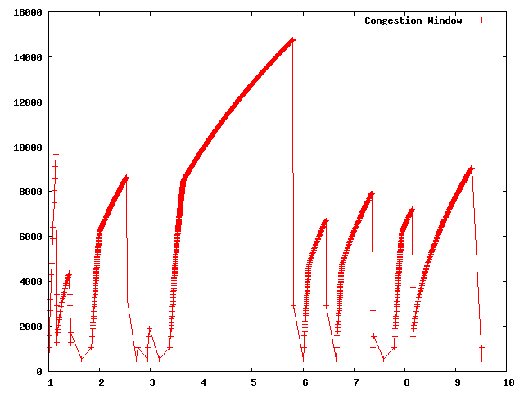
Running fifth.cc: plotting the results
Original by W. Richard Stevens
Our result, using gnuplot

Slide 45
That’s nice, but…
Remember after
We had to edit the file by hand to remove “junk” lines…
But we said tracing gives you control over output format
Is there a cleaner way to produce the output we need?
Yes! Use trace helpers
./waf –run scratch/myfifth > cwnd.dat 2>&1
Let’s tweak fifth.cc to produce cleaner output ⇒ sixth.cc

Slide 46
A sixth.cc walkthrough: CwndChange callback
Modify the callback function:
static void CwndChange (Ptr<OutputStreamWrapper> stream, uint32_t oldCwnd, uint32_t newCwnd)
{
NS_LOG_UNCOND (Simulator::Now ().GetSeconds () << "\t" << newCwnd);
*stream->GetStream () << Simulator::Now ().GetSeconds () << "\t" << oldCwnd << "\t" << newCwnd << std::endl;
}
Added to fifth.cc
Formatted output to the stream
Add lines in the main to create stream:
Filename attached to stream
AsciiTraceHelper asciiTraceHelper;
Ptr<OutputStreamWrapper> stream = asciiTraceHelper.CreateFileStream ("sixth.cwnd");
ns3TcpSocket->TraceConnectWithoutContext ("CongestionWindow", MakeBoundCallback (&CwndChange, stream));
Causes the stream argument to be added to the function callback

Slide 47
A sixth.cc walkthrough: RxDrop callback
Modify the callback function:
static void RxDrop (Ptr<PcapFileWrapper> file, Ptr<const Packet> p)
{
NS_LOG_UNCOND ("RxDrop at " << Simulator::Now ().GetSeconds ());
file->Write (Simulator::Now (), p);
}
Added to fifth.cc
Formatted output to the pcap file
Add lines in the main to create stream:
Filename attached to file
PcapHelper pcapHelper;
Ptr<PcapFileWrapper> file = pcapHelper.CreateFile ("sixth.pcap", std::ios::out, PcapHelper::DLT_PPP);
devices.Get (1)->TraceConnectWithoutContext ("PhyRxDrop", MakeBoundCallback (&RxDrop, file));
Causes the file argument to be added to the function callback

Slide 48
Running sixth.cc
1 0 536
1.00919 536 1072
1.01511 1072 1608
1.02163 1608 2144
1.02995 2144 2680
1.03827 2680 3216
1.04659 3216 3752
1.05491 3752 4288
1.06323 4288 4824
1.07155 4824 5360
1.07987 5360 5896
1.08819 5896 6432
1.09651 6432 6968
1.10483 6968 7504
1.11315 7504 8040
1.12147 8040 8576
1.12979 8576 9112
1.13811 9112 9648
⋮
./waf –run scratch/mysixth
sixth.cwnd
Console
Waf: Entering directory `…
Waf: Leaving directory `…
'build' finished successfully (6.002s)
1 536
1.00919 1072
1.01511 1608
1.02163 2144
1.02995 2680
1.03827 3216
1.04659 3752
1.05491 4288
1.06323 4824
1.07155 5360
1.07987 5896
1.08819 6432
1.09651 6968
1.10483 7504
1.11315 8040
1.12147 8576
1.12979 9112
RxDrop at 1.13692
1.13811 9648
1.15475 2900
1.15563 3436
⋮
sixth.pcap
reading from file sixth.pcap, link-type PPP (PPP)
1.136918 IP 10.1.1.1.49153 > 10.1.1.2.8080: Flags [.], seq 17177:17681, ack 1, win 65535, length 504
1.403158 IP 10.1.1.1.49153 > 10.1.1.2.8080: Flags [.], seq 33280:33784, ack 1, win 65535, length 504
1.440505 IP 10.1.1.1.49153 > 10.1.1.2.8080: Flags [.], seq 37440:37944, ack 1, win 65535, length 504
2.525484 IP 10.1.1.1.49153 > 10.1.1.2.8080: Flags [.], seq 173144:173680, ack 1, win 65535, length 536
2.534678 IP 10.1.1.1.49153 > 10.1.1.2.8080: Flags [.], seq 174720:175224, ack 1, win 65535, length 504
2.977574 IP 10.1.1.1.49153 > 10.1.1.2.8080: Flags [.], seq 180552:181088, ack 1, win 65535, length 536
5.796117 IP 10.1.1.1.49153 > 10.1.1.2.8080: Flags [.], seq 582400:582904, ack 1, win 65535, length 504
6.445077 IP 10.1.1.1.49153 > 10.1.1.2.8080: Flags [.], seq 663520:664024, ack 1, win 65535, length 504
7.359404 IP 10.1.1.1.49153 > 10.1.1.2.8080: Flags [.], seq 777384:777920, ack 1, win 65535, length 536
7.389304 IP 10.1.1.1.49153 > 10.1.1.2.8080: Flags [.], seq 781040:781544, ack 1, win 65535, length 504
8.141483 IP 10.1.1.1.49153 > 10.1.1.2.8080: Flags [.], seq 875144:875680, ack 1, win 65535, length 536

Slide 49
Just for fun: what happens to uncorrupted packets?
PhyRxEnd: Trace source indicating a packet has been completely received by the device

Slide 50
Using trace helpers
We’ve encountered trace helpers before
What other trace helpers are available?
How do we use them?
What do they have in common?
pointToPoint.EnablePcapAll ("second");
pointToPoint.EnablePcap ("second", p2pNodes.Get (0)->GetId (), 0);
csma.EnablePcap ("third", csmaDevices.Get (0), true);
pointToPoint.EnableAsciiAll (ascii.CreateFileStream ("myfirst.tr"));

Slide 51
Two categories of trace helpers
Device helpers
Trace is enabled for node/device pair(s)
Both pcap and ascii traces provided
Conventional filenames: <prefix>-<node id>-<device id>
Protocol helpers
Trace is enabled for protocol/interface pair(s)
Both pcap and ascii traces provided
Conventional filenames: <prefix>-n<node id>-i<interface id>
“n” and “i” to avoid filename collisions with node/device traces

Slide 52
NS3 uses “mixin” classes to ensure tracing works the same way across all devices or interfaces
Mixin classes in NS3 (see Doxygen for more info):
These mixin classes each provide a single virtual method to enable trace
All device or protocols must implement this method
All other methods of the mixin class call this one method
Provides consistent functionality across different devices & interfaces
 | PCAP | ASCII
Device Helper | PcapHelperForDevice | AsciiTraceHelperForDevice
Protocol Helper | PcapHelperForIpv4 | AsciiTraceHelperForIpv4

Slide 53
The PcapHelperForDevice mixin class
Every device must implement
All other methods of PcapHelperForDevice call this one
Pcap filename prefix
virtual void EnablePcapInternal (std::string prefix,
Ptr<NetDevice> nd,
bool promiscuous,
bool explicitFilename) = 0;
Device to trace
Type of trace
Override prefix
⇒ Consistency across devices

Slide 54
Pcap Tracing Device Helper: EnablePcap methods
EnablePcap for various node/device pair(s)
Provide Ptr<NetDevice>
Provide device name using the NS3 object name service
Provide a NetDeviceContainer
Provide a NodeContainer
Provide integer node and device ids
Enable pcap tracing for all devices in the simulation
Names::Add ("server" ...);
Names::Add ("server/eth0" ...);
...
helper.EnablePcap ("prefix", "server/ath0");
helper.EnablePcapAll ("prefix");

Slide 55
Pcap Tracing Device Helper: filename selection
By convention: <prefix>-<node id>-<device id>.pcap
Can use the NS3 object name service to replace ids with meaningful names e.g.,
You can override the naming convention, e.g.
prefix-21-1.pcap
Names::Add(“server”,serverNode);
Names::Add(“server/eth0”,serverDevice);
prefix-server-eth0.pcap
void EnablePcap(std::string prefix, Ptr<NetDevice> nd, bool promiscuous, bool explicitFilename);
Set this to true
prefix becomes filename

Slide 56
Ascii Tracing Device Helpers
The mixin class is AsciiTraceHelperForDevice
All device implement virtual EnableAsciiInternal method
All other methods of AsciiTraceHelperForDevice will call this one
Can provide EnableAscii with Ptr<NetDevice>, string from name service, NetDeviceContainer, NodeContainer, integer node/device ids
Or helper.EnableAsciiAll(“prefix”);
Can also dump ascii traces to a single common file, e.g.,
So there are twice as many trace methods as for pcap
Ptr<NetDevice> nd1;
Ptr<NetDevice> nd2;
...
Ptr<OutputStreamWrapper> stream = asciiTraceHelper.CreateFileStream ("trace-file-name.tr");
...
helper.EnableAscii (stream, nd1);
helper.EnableAscii (stream, nd2);

Slide 57
Ascii Tracing Device Helpers: filename selection
By convention: <prefix>-<node id>-<device id>.tr
Using NS3 object name service, can assign names to the id, then e.g.
"prefix-21-1.tr” → "prefix-server-eth0.tr”
Many EnableAscii methods offer a explicitFilename option
set to true ⇒ override naming convention, use your own file name

Slide 58
Pcap Tracing Protocol Helpers
The mixin class is PcapHelperForIpv4
All device implement virtual EnablePcapIpv4Internal method
All other methods of PcapHelperForIpv4 will call this one
Can provide EnablePcapIpv4 with Ptr<Ipv4>, string from name service, Ipv4InterfaceContainer, NodeContainer, integer node/device ids
Or helper.EnablePcapIpv4All(“prefix”);
Filename selection
Convention is <prefix>-n<node id>-i<interface id>.pcap
Can also use the NS3 object name service clarity
explicitFilename parameter lets you impose your own filenames

Slide 59
Ascii Tracing Protocol Helpers
The mixin class is AsciiTraceHelperForIpv4
All device implement virtual EnableAsciiIpv4Internal method
All other methods of AsciiTraceHelperForIpv4 will call this one
Can provide EnableAsciiIpv4 with Ptr<Ipv4>, string from name service, Ipv4InterfaceContainer, NodeContainer, integer node/device ids
Or helper.EnableAsciiIpv4All(“prefix”);
Can also dump ascii traces to a single common file
So there are twice as many trace methods as for pcap
Filename selection
Convention is <prefix>-n<node id>-i<interface id>.pcap
Can also use the NS3 object name service clarity
explicitFilename parameter lets you impose your own filenames

Slide 60
Conclusion
NS3 is very powerful/comprehensive
Lots of tools for you to use
Helpers
Containers
Logging
Tracing
Models
Doxygen is your friend!
Practice! Practice! Practice!

